Slide 1


CcpNmr Analysis Version 3
How To’s:
Import Sparky project

Slide 2

Introduction
This How-To will show how to import a Sparky project directly to CcpNmr Analysis V3.
NB. In the current release of Analysis, the sparky reader is still under development, we cannot guarantee that all Sparky projects will be opened correctly.
Start CcpNmr Analysis V3
Apple users by double clicking the icon CcpNmrAnalysis
Linux users by using the terminal command: bin/assign

Slide 3
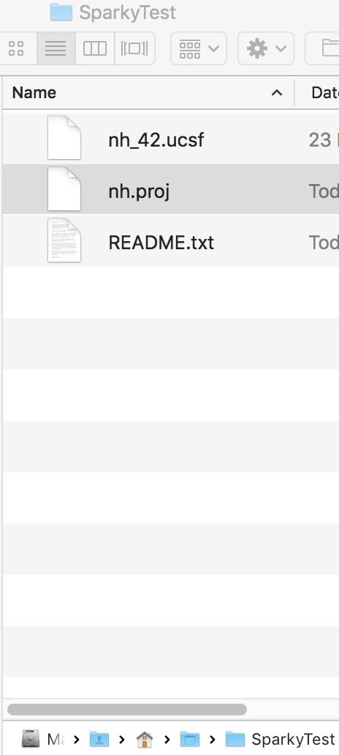
How To
1
Import Sparky
Drop nh.proj
1A
Drop a *.proj file
Find a sparky project on SparkyTest directory
Simply Drag and drop the file nh.proj onto the sidebar or Drop Area
The project should be fully loaded.
All the spectra and other data will be located in sidebar.
Go on sidebar, expand the Spectra branch
Select the item SP:nh_42
Drag and drop on the drop area

Slide 4
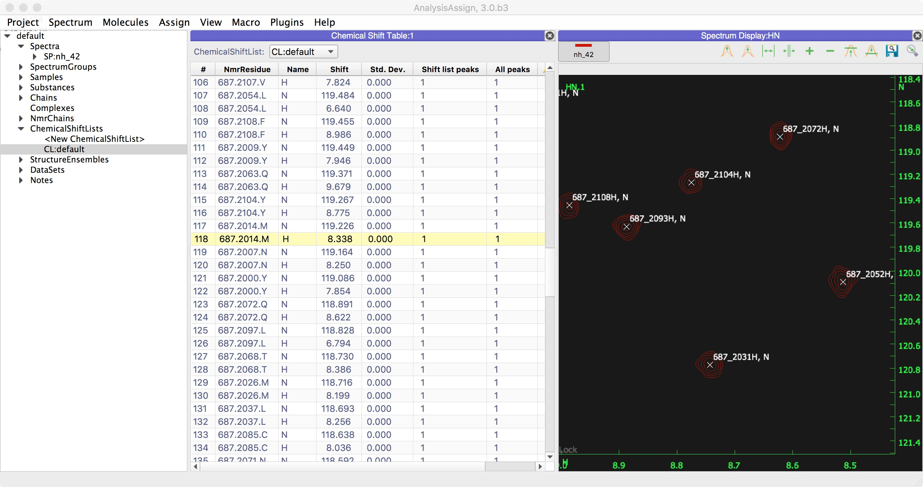
How To
1
Import Sparky
1B
Open the Chemical Shift list
If you had an assignment in the sparky project, you may want to see the chemical shift list
Go on sidebar, expand the ChemicalShiftLists branch
Select the item CL:default
Drag and drop on the drop area

Slide 5
CcpNmr Analysis Version 3
Contact Us
Website:
www.ccpn.ac.uk
Suggestions and comments:
ccpnmr3@google.com
Issues and bug report:
https://bitbucket.org/ccpnmr/issue-tracker/
Cite Us
CcpNmr AnalysisAssign: a flexible platform for integrated NMR analysis
Tutorial Version History:
beta3 (LGM): First version

